Slide 1

Shield Insurance Dashboard
Empowering Insurance Intelligence
Designed by Devika Suresh | Atliq Technologies

Slide 2





About Shield Insurance
Shield Insurance, established in Mumbai in 2015, is a leading health and general insurance provider in India. The company focuses on a digital-first approach to serve over 1 million customers with diverse insurance products.
Established in 2015
Comprehensive Products
1M+ Customers
Headquartered in Mumbai, India.
Offers health, motor, travel, and personal accident policies.
Strong focus on digital-first services.
AI-Driven Insights
Affordable Solutions
Leverages AI and analytics for efficiency.
Committed to accessible, personalized insurance.

Slide 3
Problem Statement: Unlocking Business Insights
Shield Insurance aims to gain actionable insights by analyzing key aspects of its business to drive growth and improve customer experience.
Customer & Revenue Understanding
Deepen understanding of the customer base and revenue generation patterns.
Key Metric Monitoring
Track total customers, total revenue, daily customer growth, and daily revenue growth.
Sales Performance Analysis
Evaluate sales performance by sales modes and age group behavior.
Policy Trend Identification
Monitor monthly policy trends to identify growth opportunities.
Preference & Settlement Rates
Understand policy preferences and expected settlement rates across age groups.

Slide 4
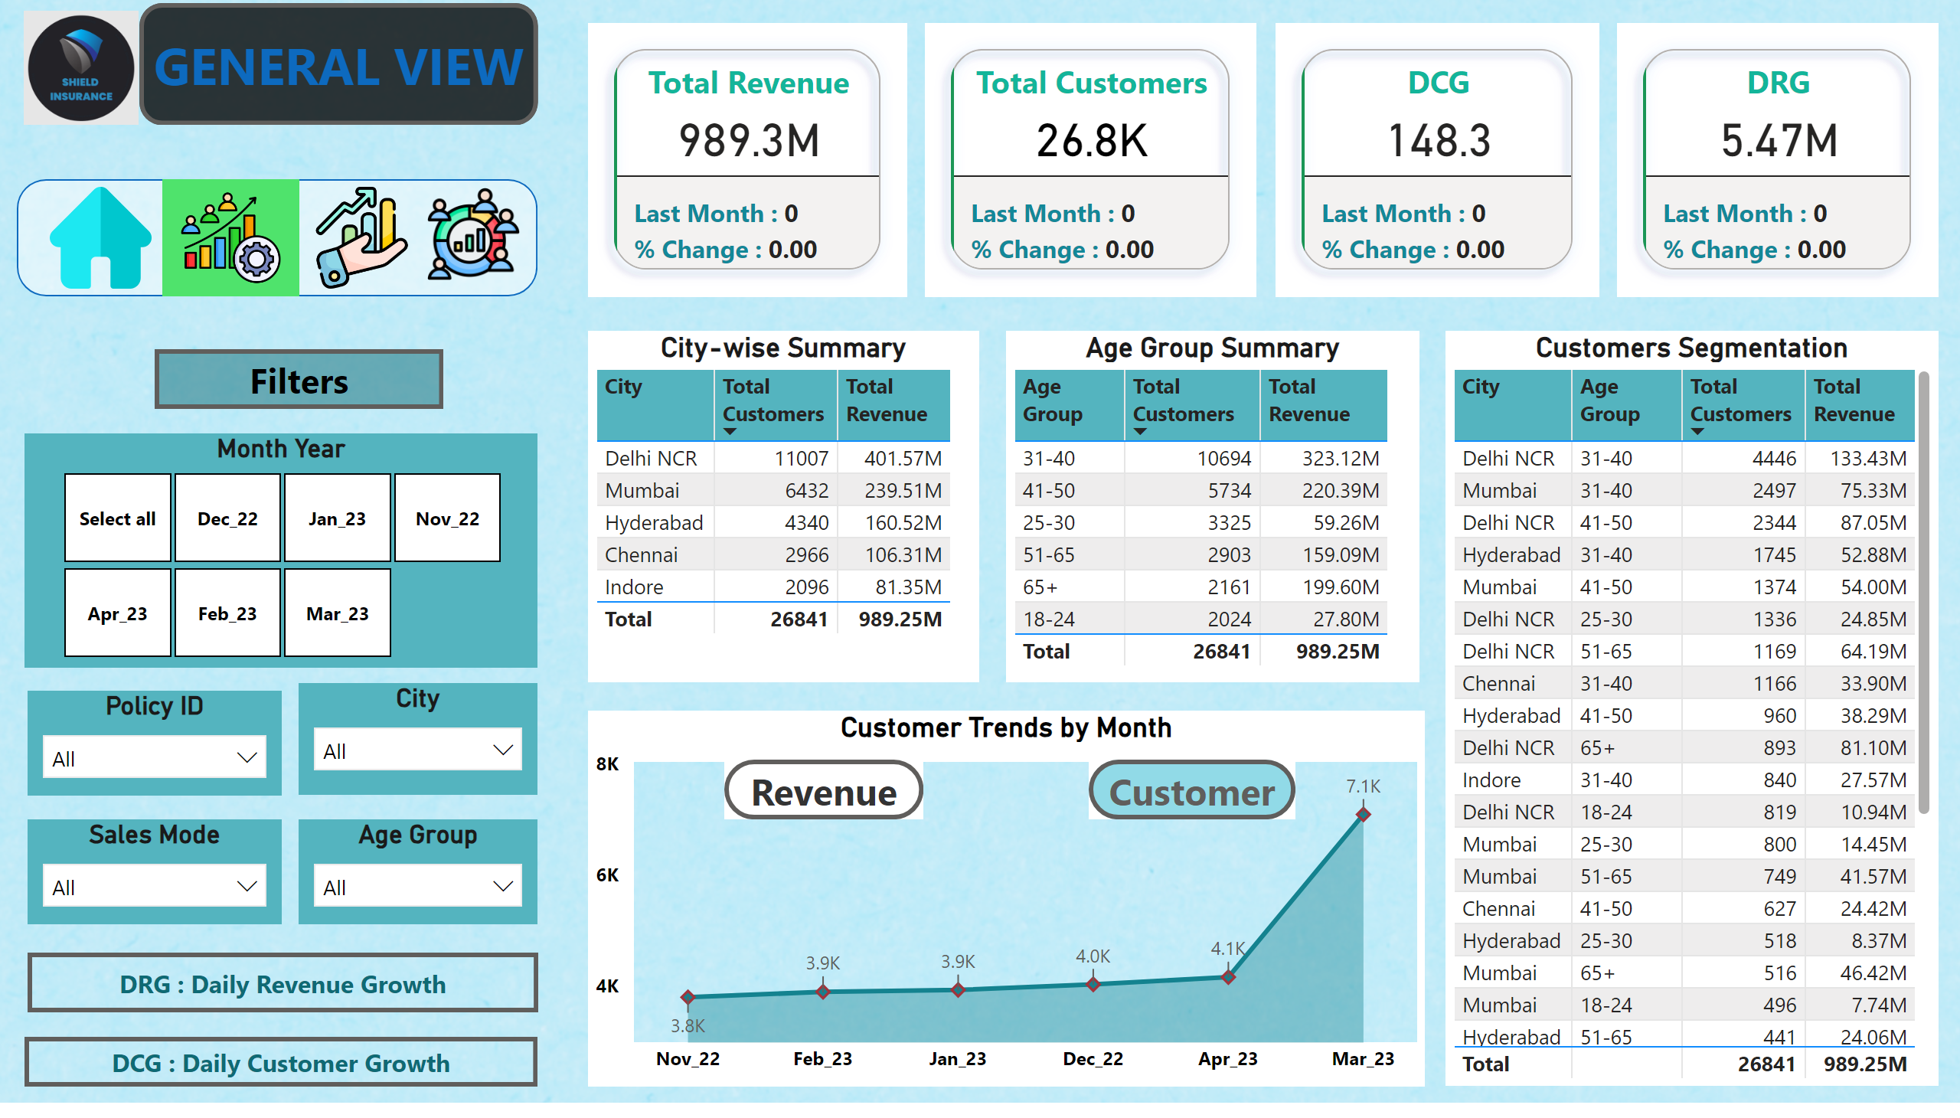
General View
Notes:
lineChart
No alt text provided
Customer Trends by Month
No alt text provided
Revenue 1
No alt text provided
actionButton
No alt text provided
City-wise Summary
No alt text provided
Age Group Summary
No alt text provided
image
No alt text provided
actionButton
No alt text provided
Customers Segmentation
No alt text provided
actionButton
No alt text provided
Customer 2
No alt text provided
Age Group
No alt text provided
City
No alt text provided
Sales Mode
No alt text provided
Policy ID
No alt text provided
Month Year
No alt text provided
cardVisual
No alt text provided
cardVisual
No alt text provided
cardVisual
No alt text provided
cardVisual
No alt text provided
shape
No alt text provided
image
No alt text provided
image
No alt text provided
image
No alt text provided
image
No alt text provided
actionButton
No alt text provided
actionButton
No alt text provided
actionButton
No alt text provided

Slide 5
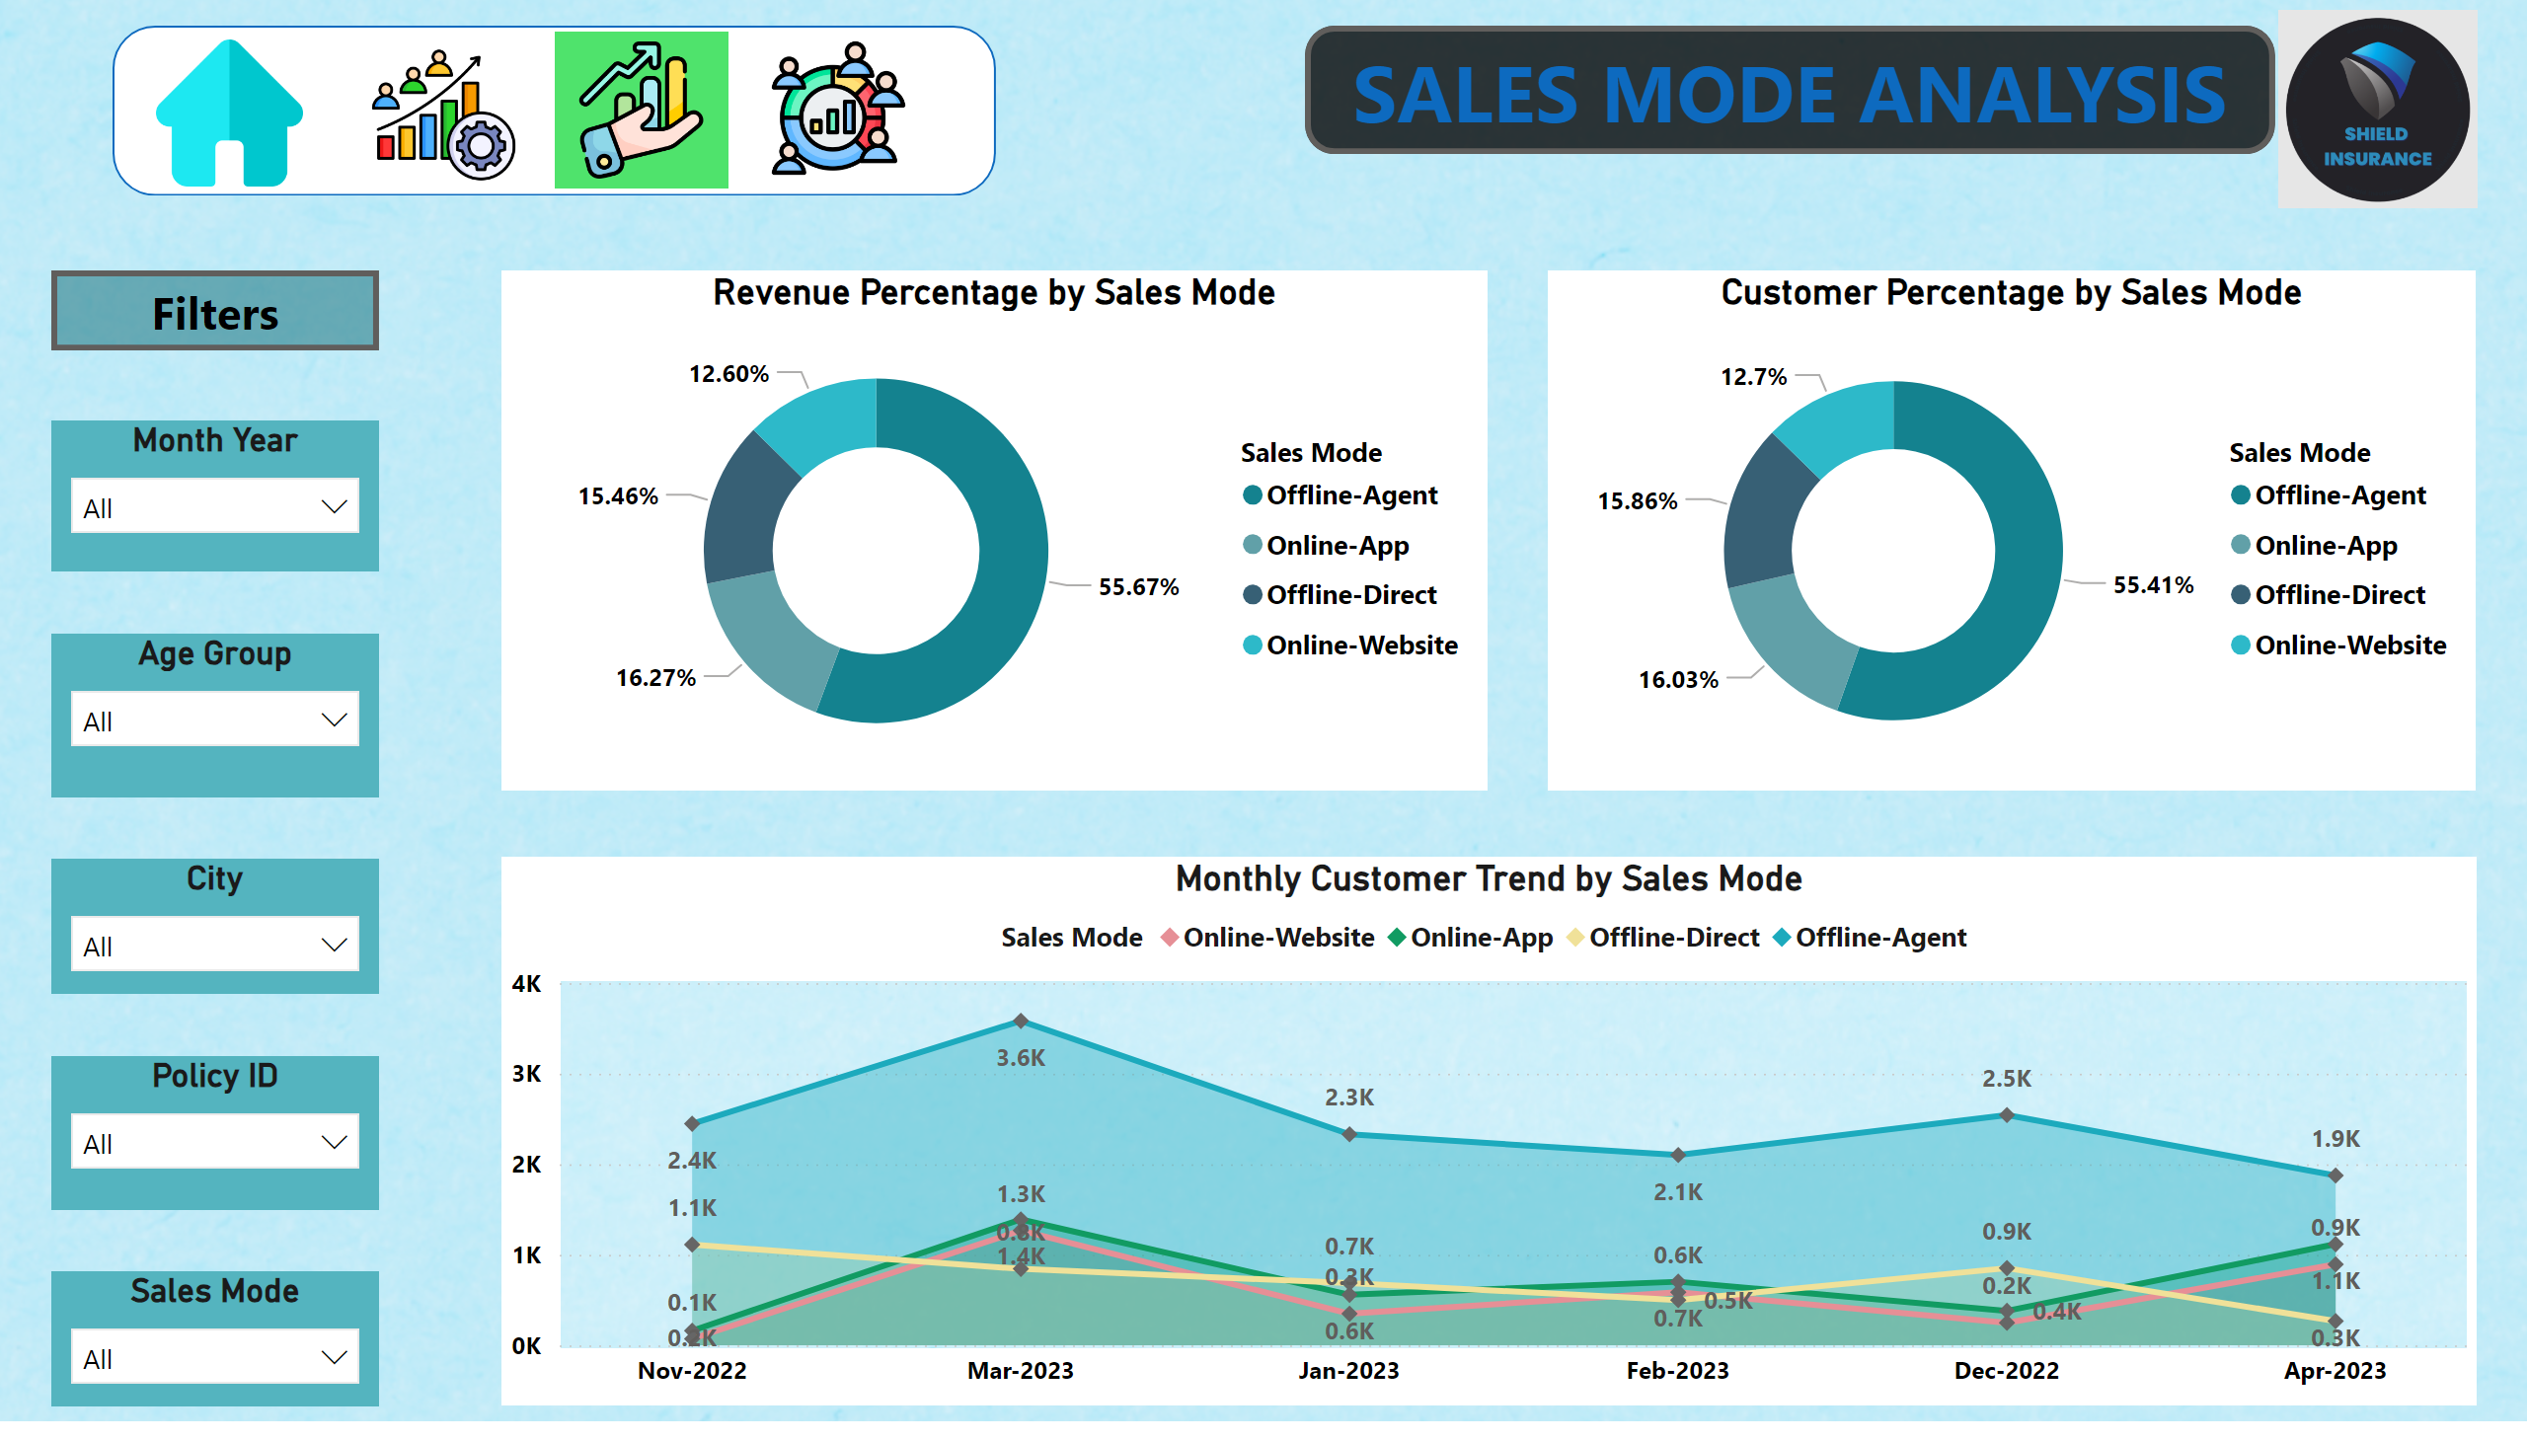
Sales Mode Analysis
Notes:
Revenue Percentage by Sales Mode
No alt text provided
Monthly Customer Trend by Sales Mode
No alt text provided
image
No alt text provided
actionButton
No alt text provided
Customer Percentage by Sales Mode
No alt text provided
Age Group
No alt text provided
City
No alt text provided
Sales Mode
No alt text provided
Policy ID
No alt text provided
Month Year
No alt text provided
shape
No alt text provided
image
No alt text provided
image
No alt text provided
image
No alt text provided
image
No alt text provided
actionButton
No alt text provided

Slide 6
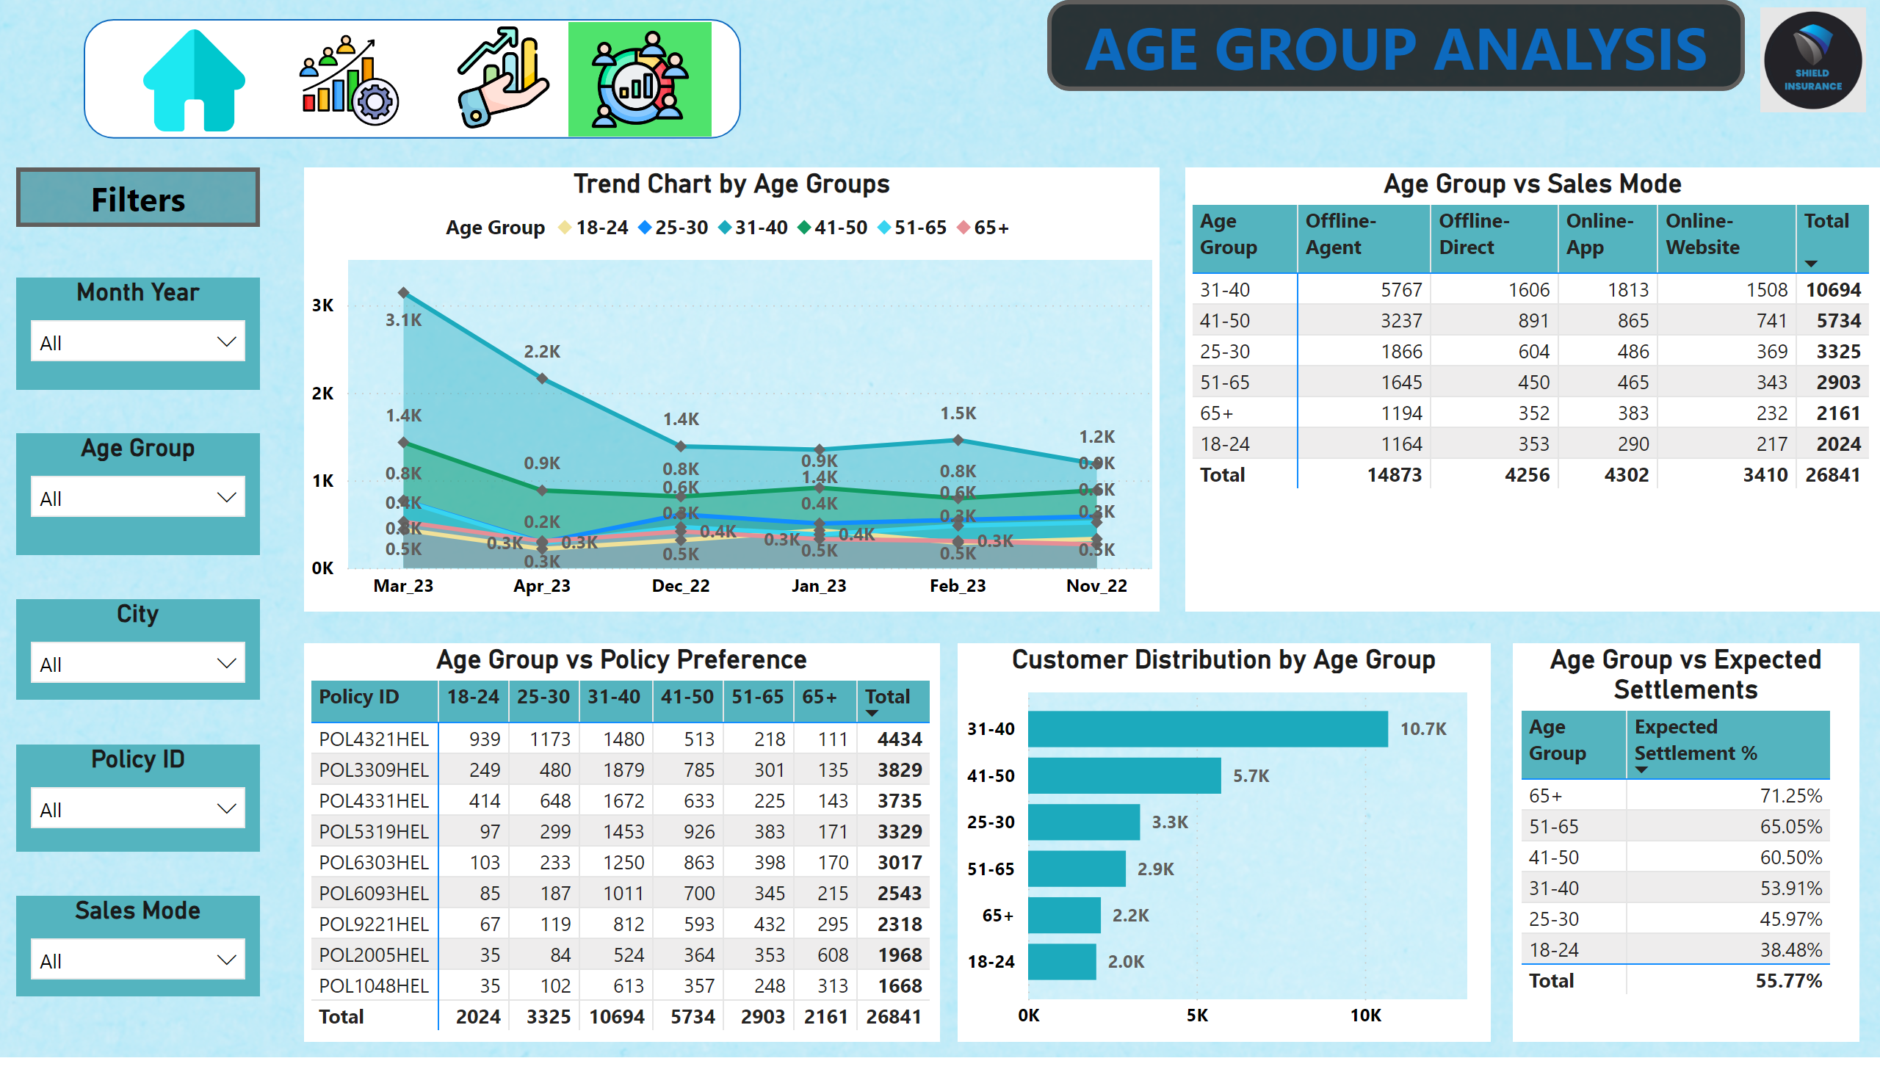
Age Group Analysis
Notes:
image
No alt text provided
actionButton
No alt text provided
Customer Distribution by Age Group
No alt text provided
Trend Chart by Age Groups
No alt text provided
Age Group vs Policy Preference
No alt text provided
Age Group vs Sales Mode
No alt text provided
Age Group vs Expected Settlements
No alt text provided
Age Group
No alt text provided
City
No alt text provided
Sales Mode
No alt text provided
Policy ID
No alt text provided
Month Year
No alt text provided
shape
No alt text provided
image
No alt text provided
image
No alt text provided
image
No alt text provided
image
No alt text provided
actionButton
No alt text provided

Slide 7
Key Insights: General Overview
Analyzing the overall business performance reveals significant strengths and areas for strategic focus.
Customer & Revenue Milestones
Top-Performing Region
Shield Insurance serves 26.8K customers, generating ₹989.3M in total revenue, showcasing strong market presence and financial performance.
Delhi NCR leads with 11,007 customers and ₹401.57M revenue, making it the highest-contributing region and a potential model for other cities.
Seasonal Trends
Most Popular Policy
March 2023 recorded peak revenue, while November 2022 was the lowest, indicating important seasonal fluctuations that warrant further investigation.
Policy POL4321HEL is the most subscribed with 4,434 customers, suggesting a strong product-market fit and consumer preference.

Slide 8
Key Insights: Sales & Age Group Dynamics
Understanding sales channel effectiveness and customer demographics is crucial for refining acquisition and retention strategies.
Sales Mode Analysis
Age Group Insights
Offline Agent dominates, accounting for 55.67% of revenue and 55.41% of customer acquisitions.
The 31–40 age group is the largest customer base with 10,696 individuals, generating ₹322.94M in revenue.
Online App and Offline Direct show similar contributions, highlighting opportunities for digital channel growth.
The 65+ age group has the highest expected settlement rate (71.25%), signaling a critical segment for targeted retention and specialized product offerings.

Slide 9

Strategic Recommendations: Growth & Engagement
Based on our analysis, we propose strategic actions to capitalize on strengths and address areas for improvement.
Leverage Delhi's Success
Replicate Delhi's performance in other metro cities through localized marketing campaigns and strategic outreach efforts.
Engage 31–40 Age Group
Develop personalized policies and targeted awareness programs for this key demographic to deepen engagement and loyalty.
Address April Dip
Investigate the reasons for the April dip in customers and revenue, implementing timely seasonal campaigns and offers to prevent future declines.

Slide 10




Strategic Recommendations: Product & Channel Optimization
Optimizing our product portfolio and diversifying sales channels are key to sustained growth and competitive advantage.
Optimize Products
Use POL4321HEL (customer leader) and POL2005HEL (revenue leader) as benchmarks to develop new offerings aligned with market demand.
Strengthen Awareness of Digital Channels
Increase visibility and adoption of Online App, Website, and Offline Direct channels through tutorials, incentives, and cross-selling by agents.
Monitor & Adapt
Continuously monitor performance metrics and adapt strategies to evolving customer needs and market dynamics, ensuring long-term success.

